Slide 1

K A S A
N
E
H
L
E
X
H
U
L
A
N
L
F
O
N
S
O

Slide 2
4 0 m i l l i o n
Internally Displaced People (IDP)
worldwide

Slide 3
1.7 m i l l i o n
Internally Displaced People (IDP)
in Nigeria

Slide 4

C H A L L E N G E
The Land Where Displaced People Settle

Slide 5
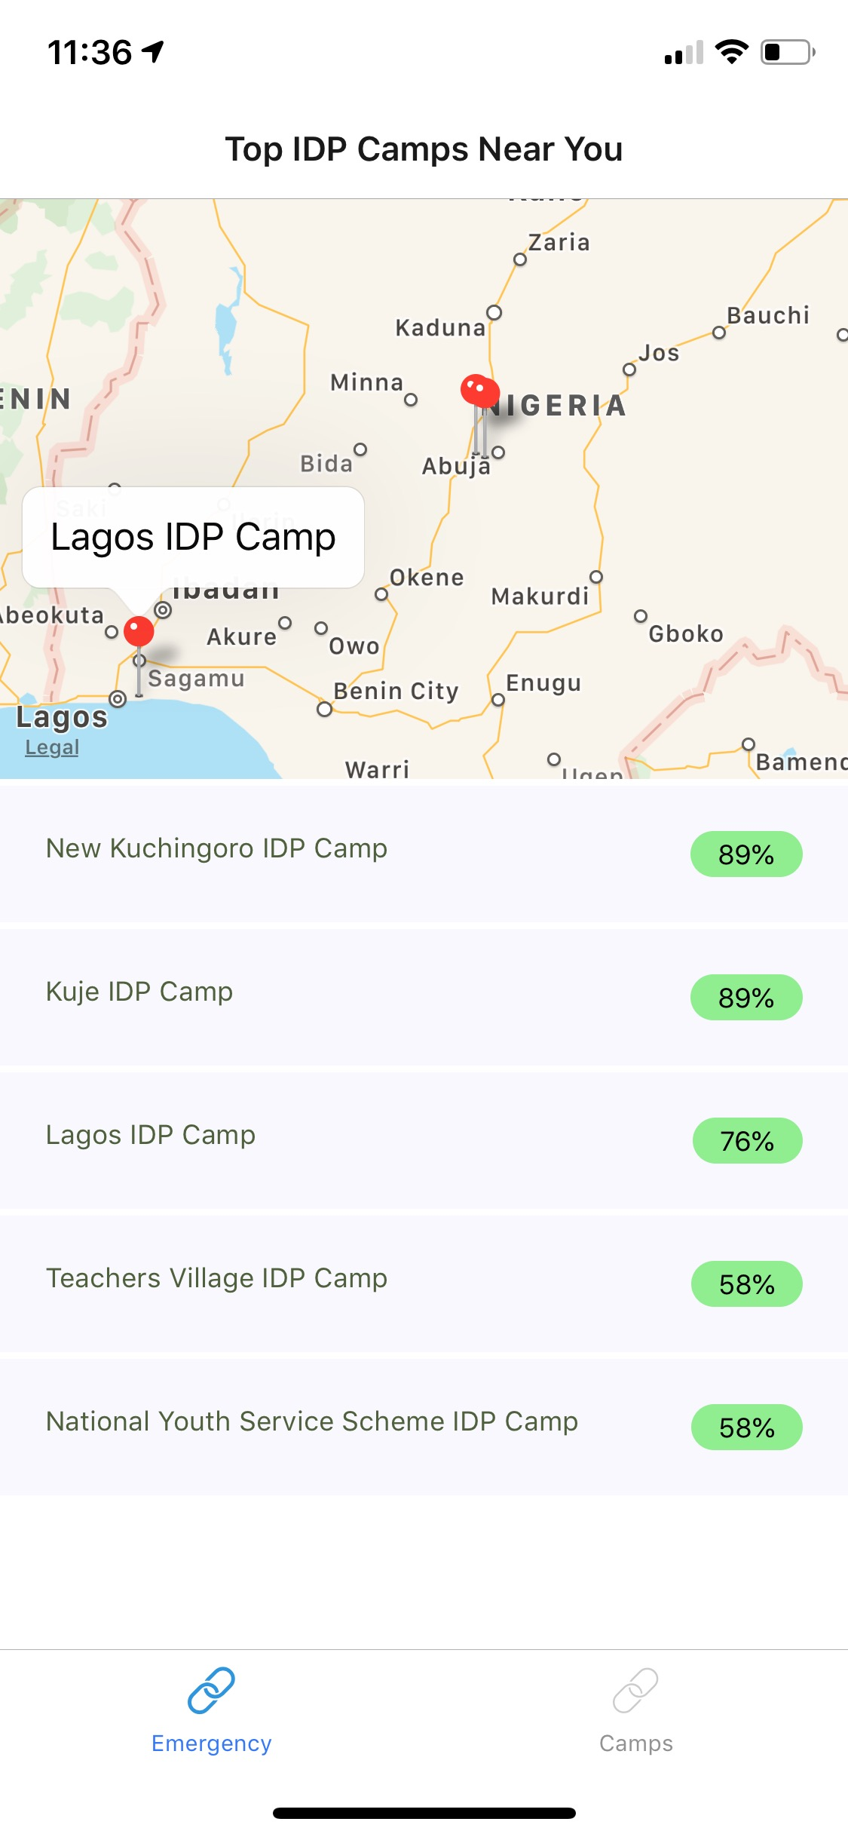
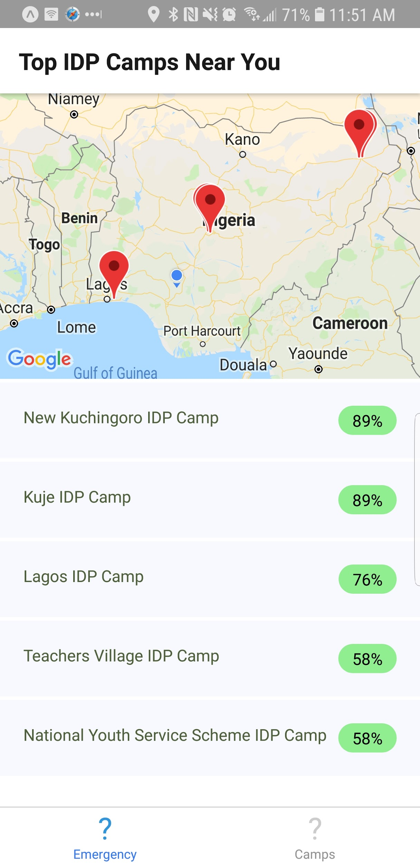
USER-SPECIFIC RECOMMENDATIONS

Slide 6
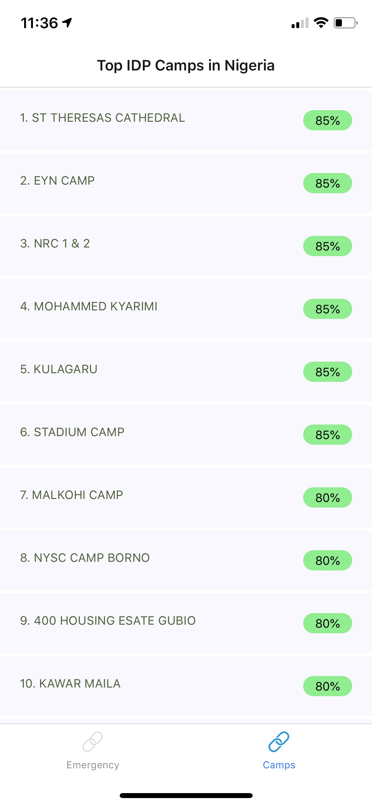
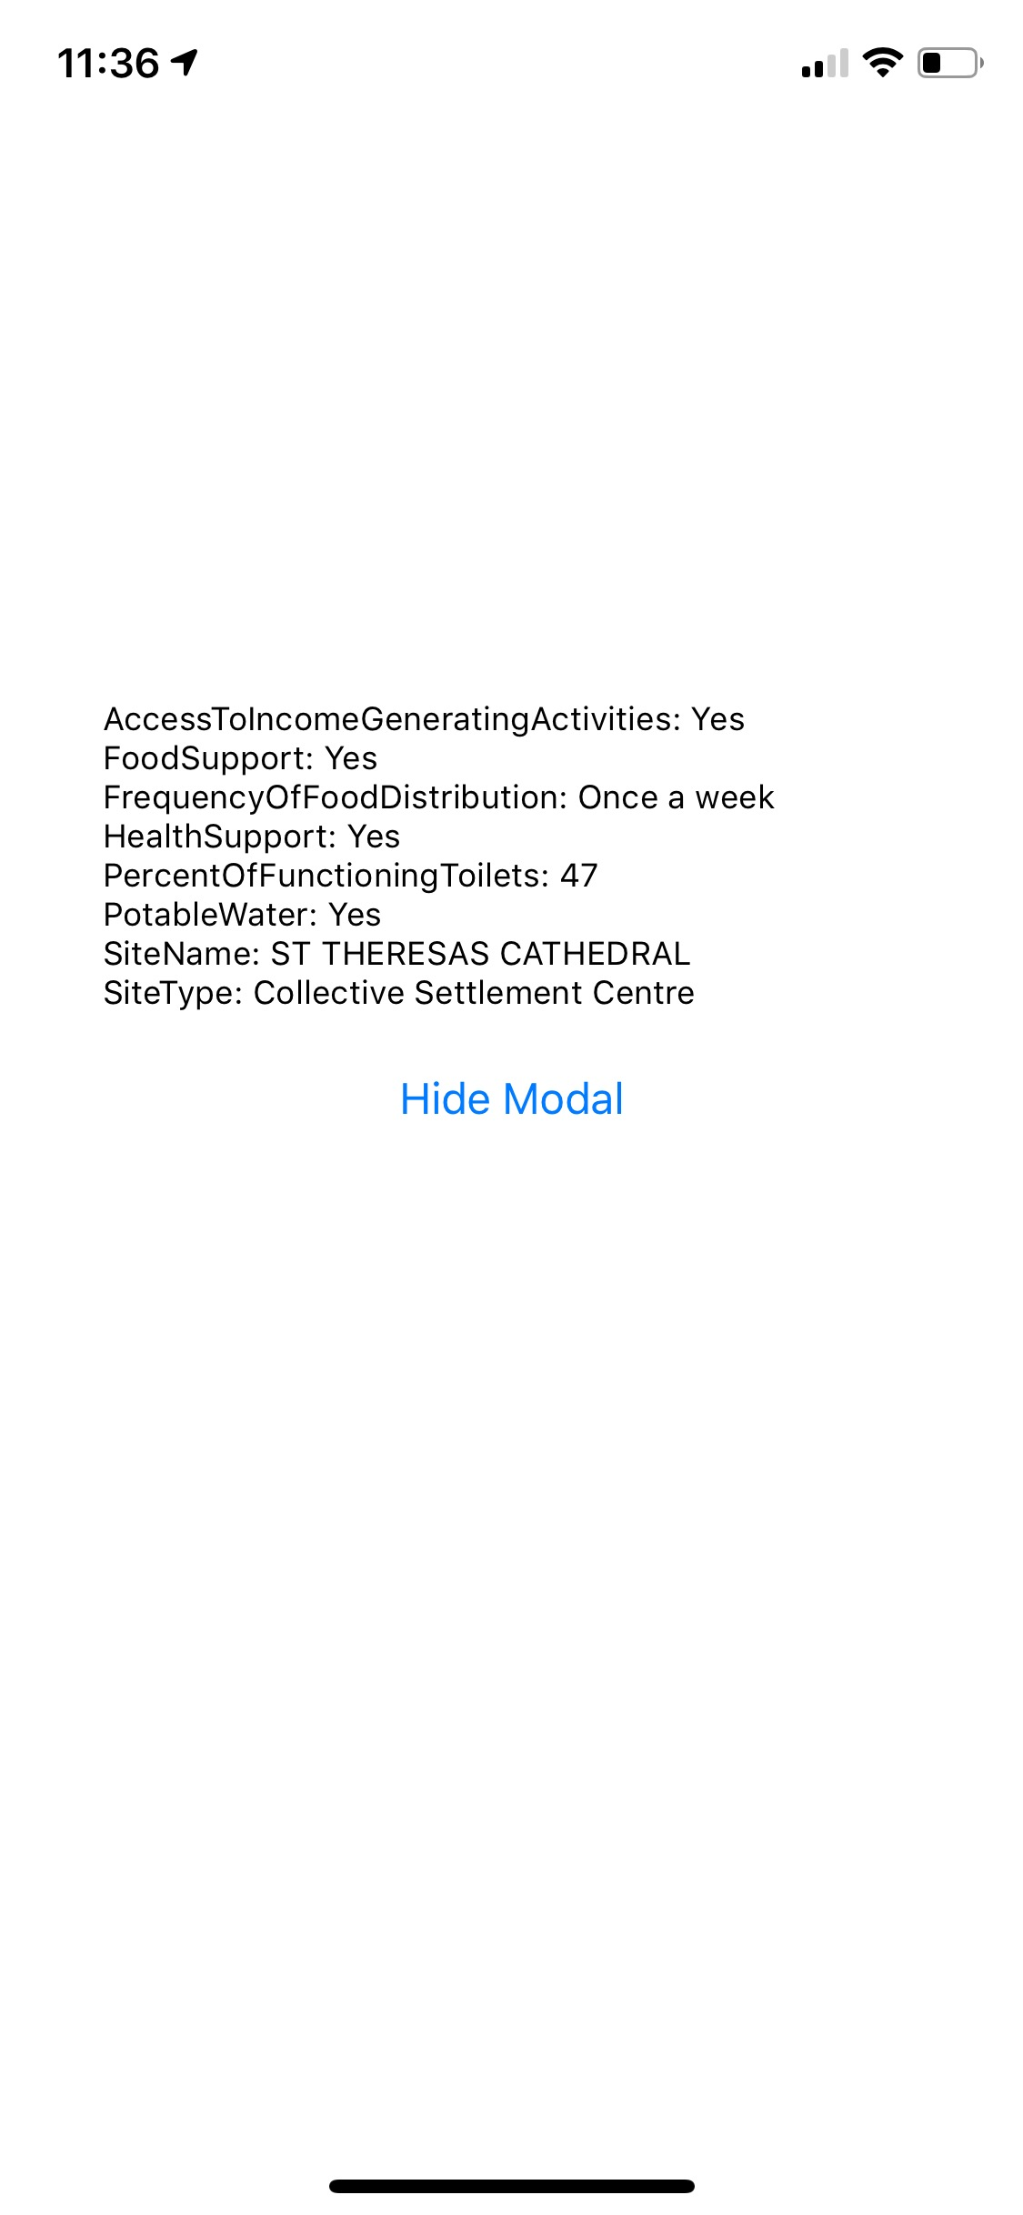
OVERALL CAMP RECOMMENDATIONS

Slide 7
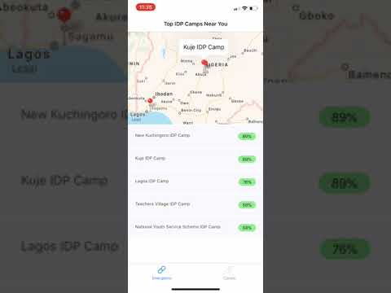

Slide 8

Access to Potable Water
Health Support
Vegetation Index
SCORING
CRITERIA
Availability of Facilities
Shelter Support
Population Density
Distance from User’s Location
Income Generating Activities
Educational Facilities
Food Support
Protection Support
Near Major Cities

Slide 9
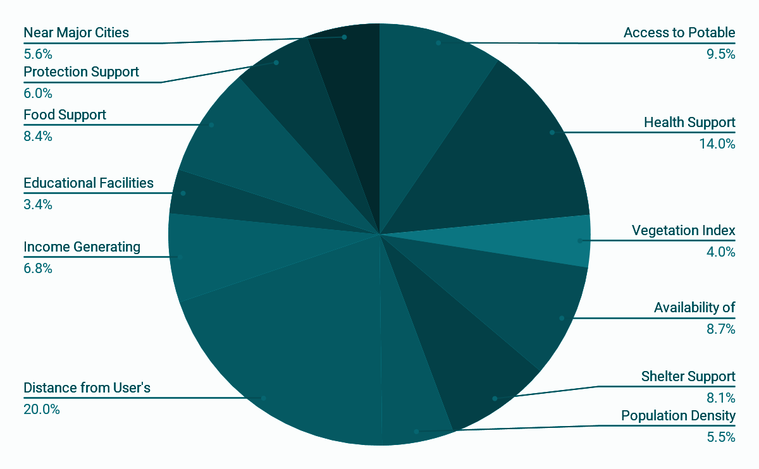
WEIGHTED
SCORING

Slide 10




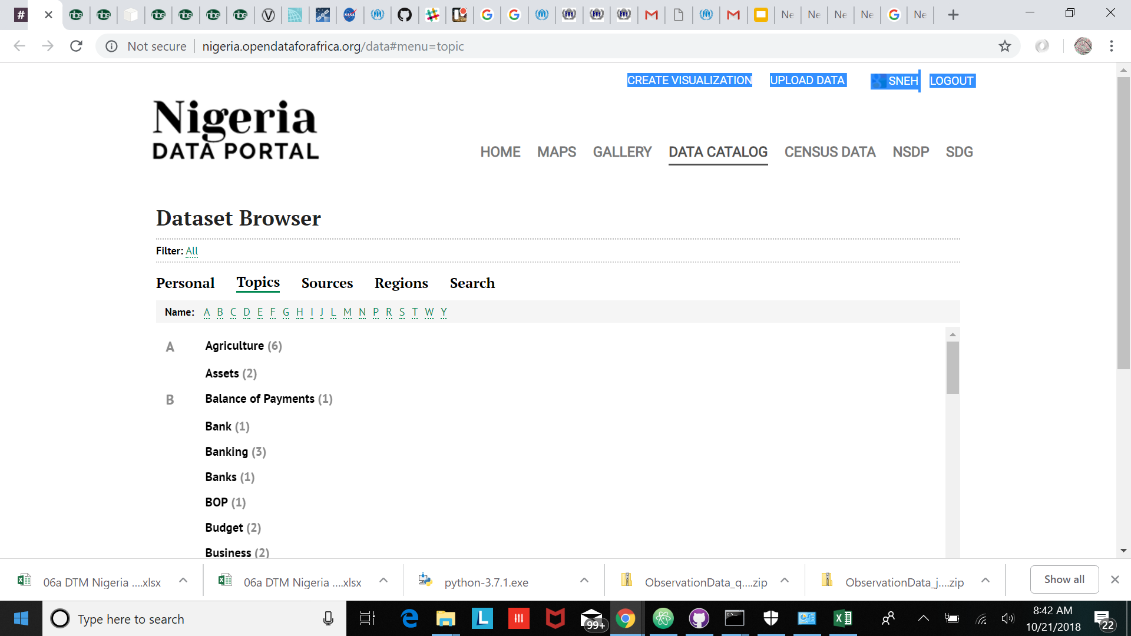

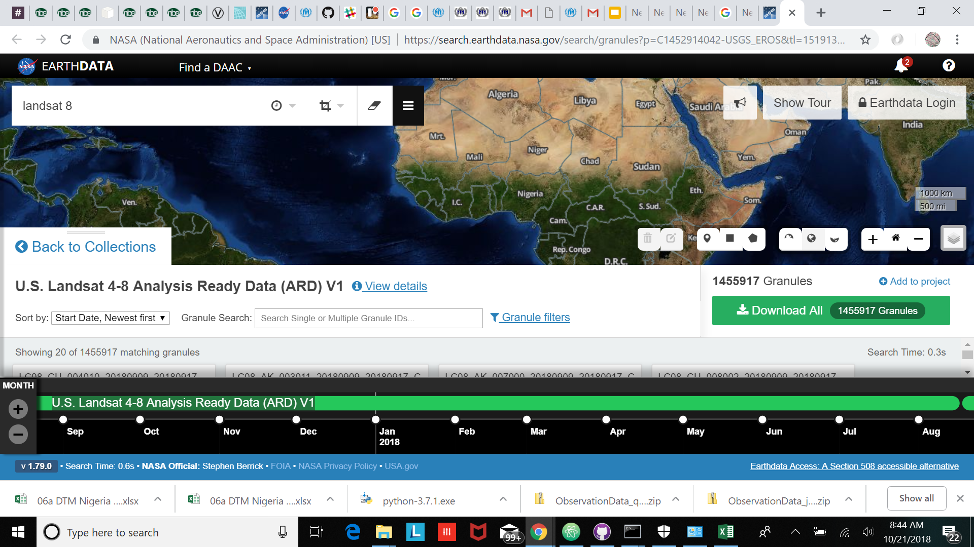
UI
TECH STACK
Services
Data Sources

Slide 11

Expose APIs to make scoring criteria datasets available.
Extend the application to other countries which are prone to IDP populations.
FUTURE WORK

Slide 12
THANK YOU
Notes:
1.7 million in nigeria IDMC

